Slide 1
Kaggle
Fb: Human vs Robot

Slide 2
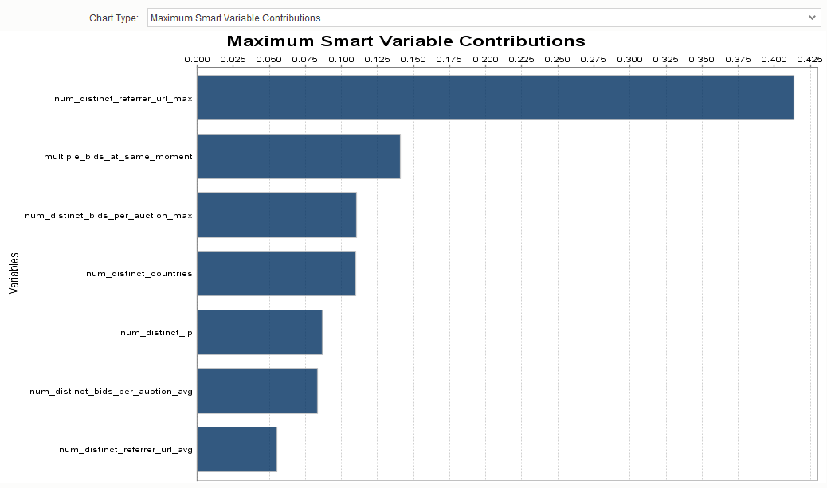
Model 004 Granular + Summary Statistics

Slide 3
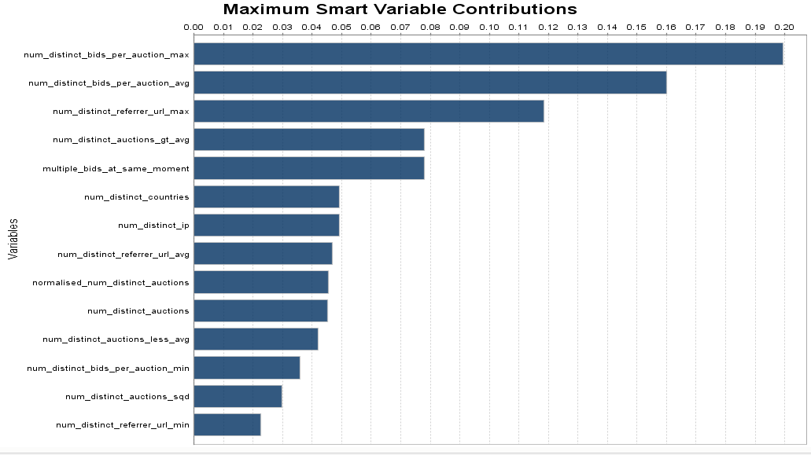
Model 003 Summary Statistics Only

Slide 4
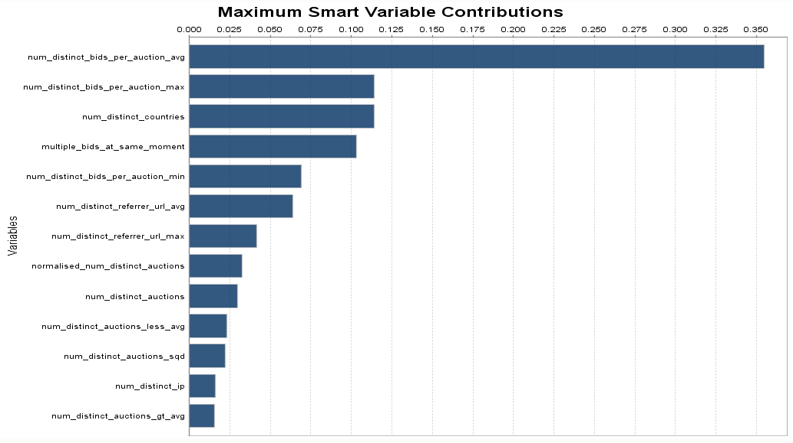
Model 002 Summary Statistics Only
Contribution of Variables

Slide 5
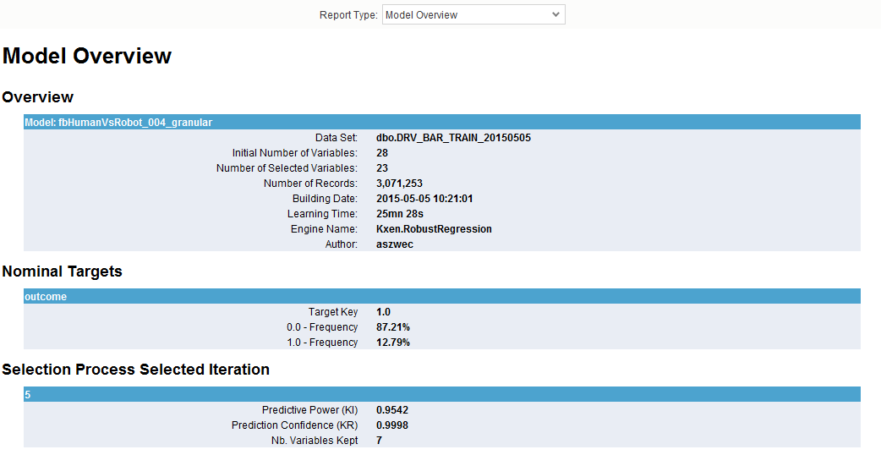
Model 004 Granular + Summary Statistics

Slide 6
Model 004 Granular + Summary Statistics

Slide 7
Model 004 Granular + Summary Statistics

Slide 8
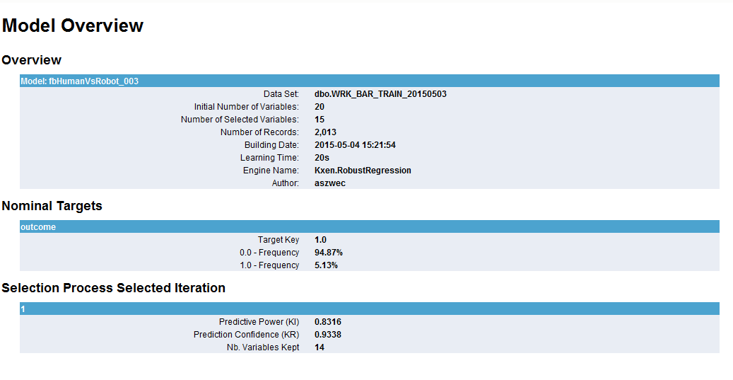
Model 003 Summary Statistics Only

Slide 9
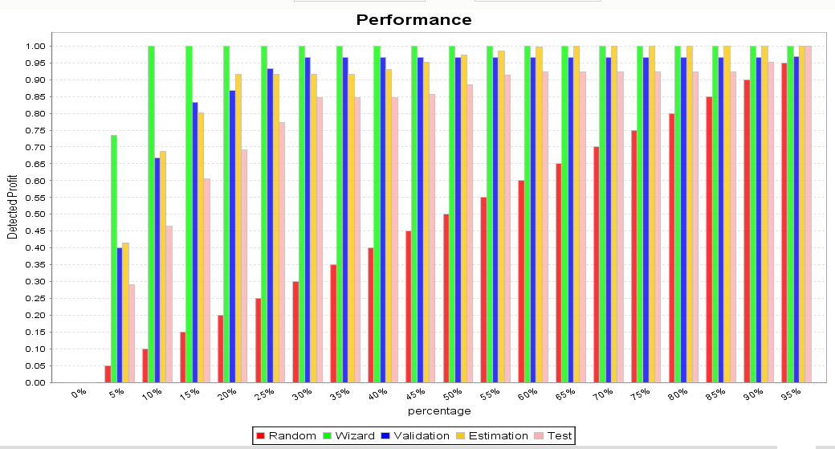
Model 003 Summary Statistics Only

Slide 10
Model 003 Summary Statistics Only

Slide 11
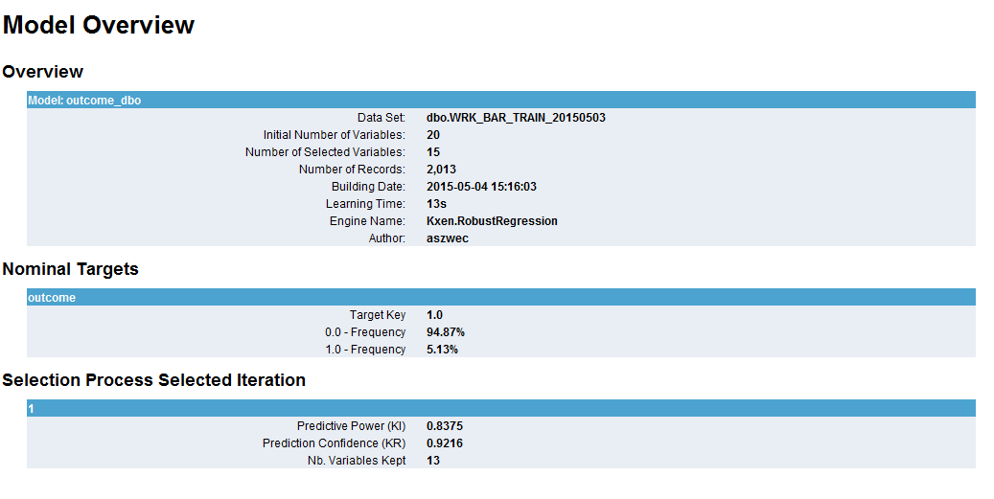
Model 002 Summary Statistics Only
SII Model Overview

Slide 12
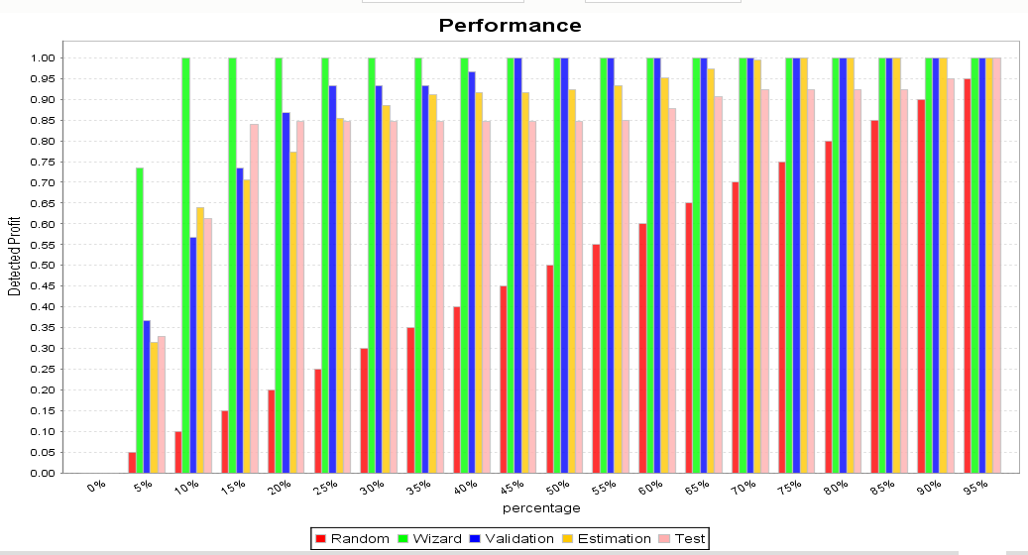
Model 002 Summary Statistics Only
Model Performance

Slide 13
Model 002 Summary Statistics Only
Contribution of Variables

Slide 14
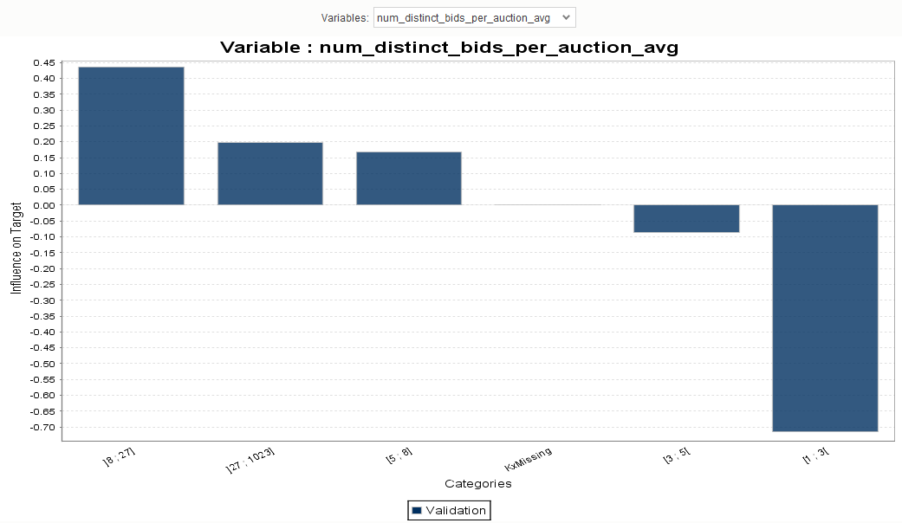
Model 002 Summary Statistics Only
1st Variable of high contribution

Slide 15
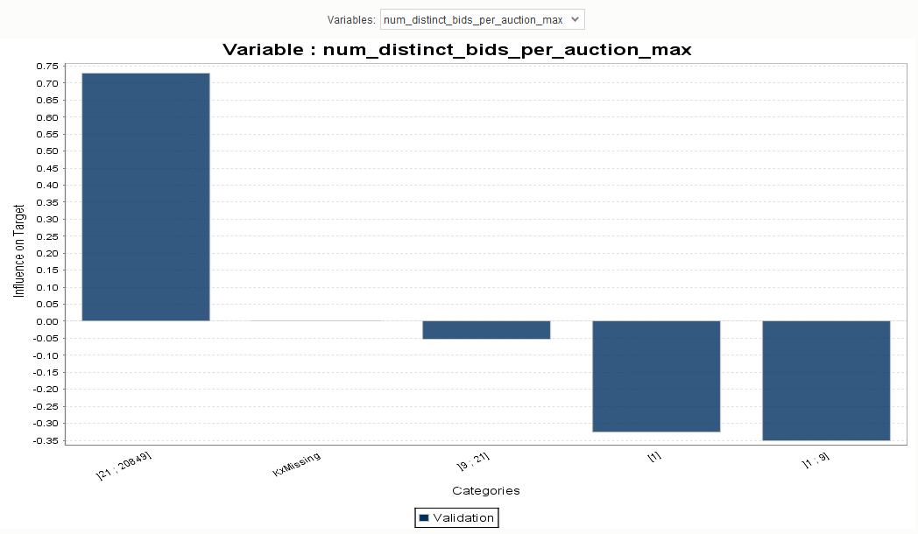
Model 002 Summary Statistics Only
2nd Variable of high contribution

Slide 16
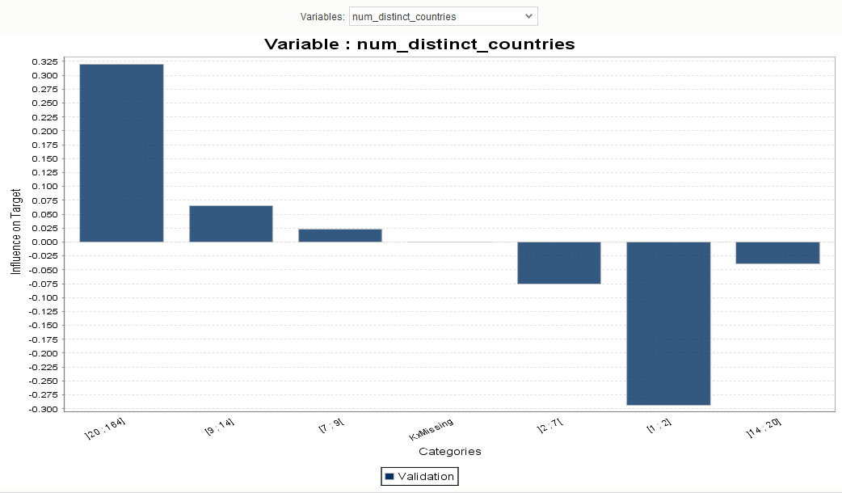
Model 002 Summary Statistics Only
3rd Variable of high contribution

